Slide 1


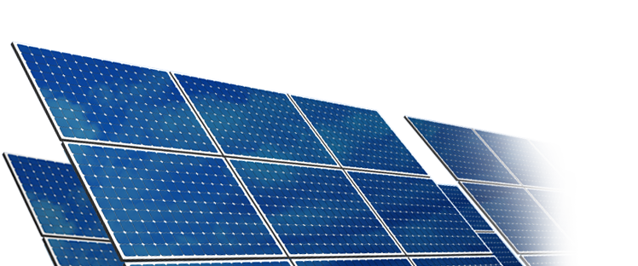
SOLAR ENERGY
By
M. JOEL FRANKLIN ASARIA
SENIOR DEPUTY DIRECTOR
NPC - CHENNAI

Slide 2

The Sun
Largest member of solar system.
Intensely hot gaseous sphere.
Core temperature is 15 million degree C and Surface temperature is about 5800 K.
Diameter 13,90,000 km, Mass consists of 75% Hydrogen and 25% Helium.
Fusion reaction generates Energy about 386 billion megawatts.
Radiation strikes the earth with in 8 minutes.
30 minutes of radiation is equal to the world energy demand for one year

Slide 3


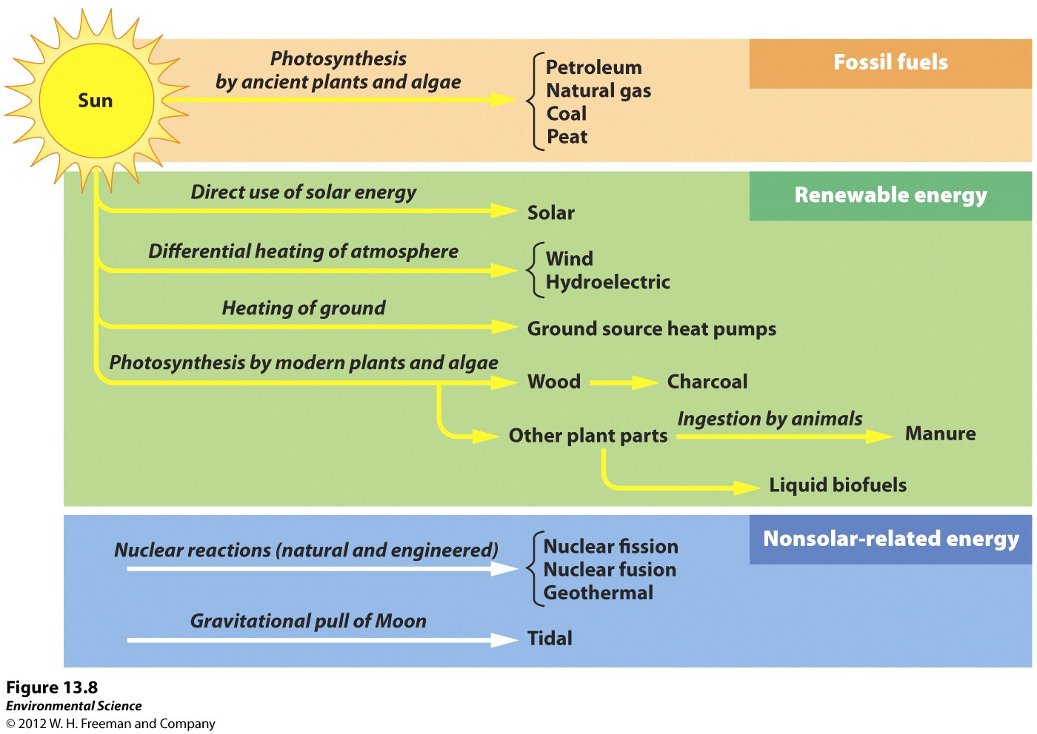
Sun – The Mother
Source : www.newpathlearning.com/photosynthesis-respiration-bulletin-board-chart

Slide 4
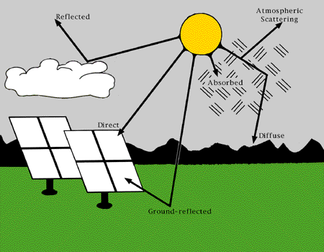
Solar Radiation

Slide 5
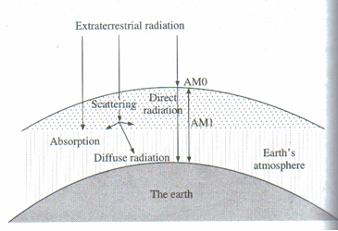
RADIATION ON THE EARTH SURFACE
Schematic diagram showing extraterrestrial radiation, direct and diffuse radiation and air mass.

Slide 6
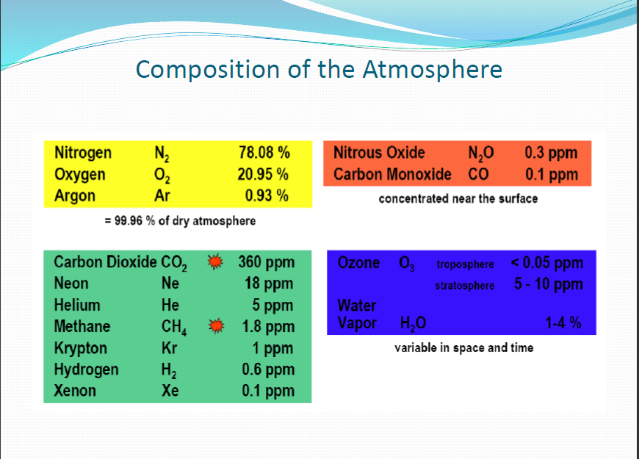

Slide 7
Solar energy reaching earth’s surface at different sun’s Positions
Distance travelled by sun rays to reach earth’s surface, or Air Mass | Solar radiation flux reaching the surface (W / m²)
AM 0 ( extraterrestrial ) | 1 376
AM 1 ( sun at overhead position ) | 1 105
AM 1.5 ( sun at about 48° from overhead position ) | 1 000
AM 2 ( sun at about 60° from overhead position ) | 894

Slide 8
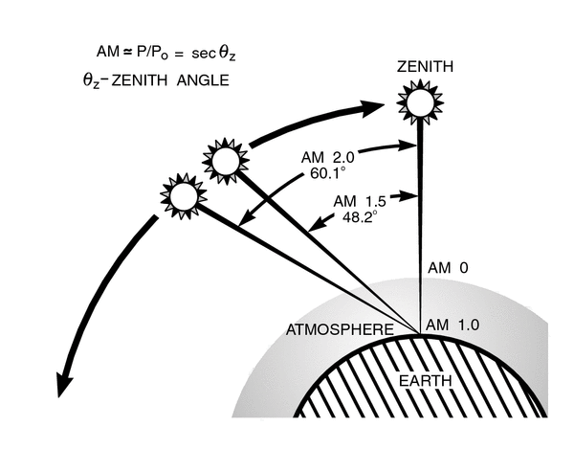
AIR MASS

Slide 9

SOLAR RESOURCE
Site selection and planning of PV power system requires reliable solar resource data.
There are two main sources of solar resource data: satellite derived data and land-based measurement.
The solar resource of a location is usually defined by the values of the global horizontal irradiation, direct normal irradiation and diffuse horizontal irradiation .
Global Horizontal Irradiation (the total solar energy received on a unit area of horizontal surface) is generally of most interest to Solar PV power developers.
As solar resource is inherently intermittent, an understanding of inter-annual variability is important.
Notes:
India is endowed with vast solar energy potential. About 5,000 trillion kWh per year energy is
incident over India’s land area with most parts receiving 3
-
5 kWh per sq. m per day. Based
upon the availability of land and solar radiation, the potential of s
olar power in the country has
been assessed to be 750 GWp.

Slide 10
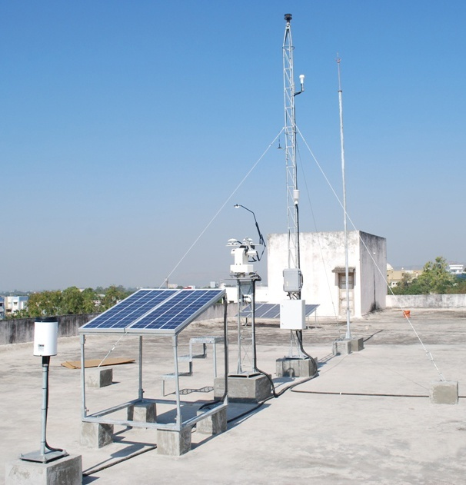
A typical SRRA station
6 m wind mast
Lightening arrestor
tower
PV panel
Rain gauge
Solar tracker at 1.5 m

Slide 11
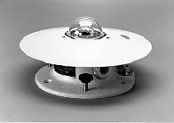
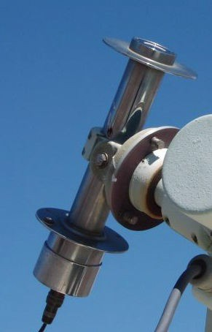
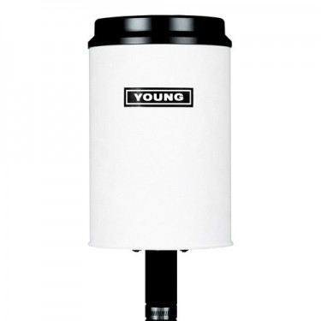

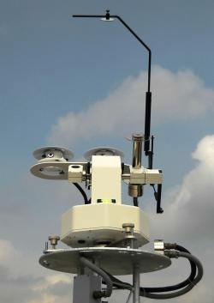
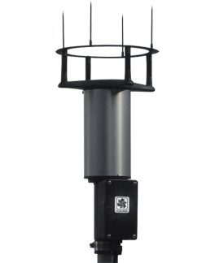
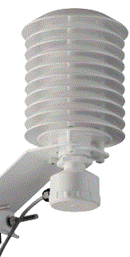
Pyrheliometer
Pyranometer
Solar Tracker with Pyranometer & Pyrheliometer.
Ultrasonic Anemometer
Temperature & Humidity sensor
Rain Gauge
Baro meter

Slide 12
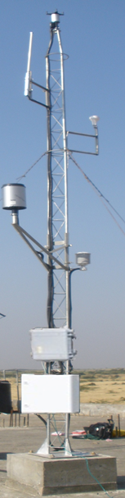
SOLAR DATA ANALYSIS
Solar resource data are available from various sources - Indian Meteorological Department, NASA’s Surface Meteorology and Solar Energy data set, METEONORM’s global climatological database, Solar data products from the United States National Renewable Energy Laboratory.
Since different data sources have particular merits, the choice will depend on the specific site
Land based site measurement (111 SRRA Stations) resource data can be used to calibrate resource data from other sources (satellites or meteorological stations) in order to improve accuracy and certainty.

Slide 13
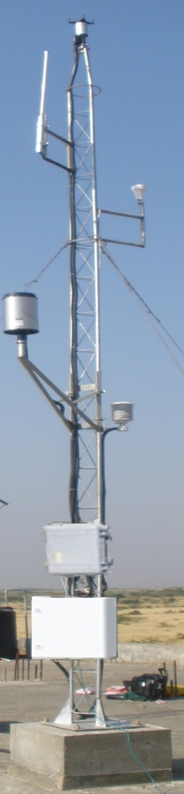
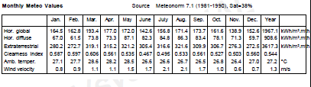
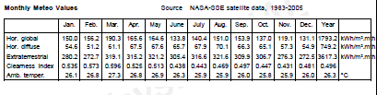

SOLAR DATA BASE
Meteonorm
10 years data
1981 to 1990
NASA - SSE
22 years data
1983 to 2005
SRRA - Kayathar
4 years data
2012 to 2016
Notes:
SRRA data 2012 on wards

Slide 14
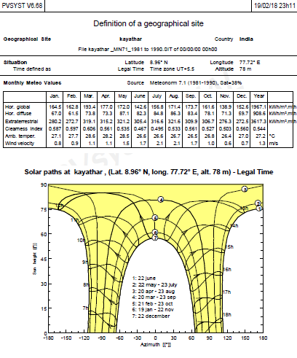

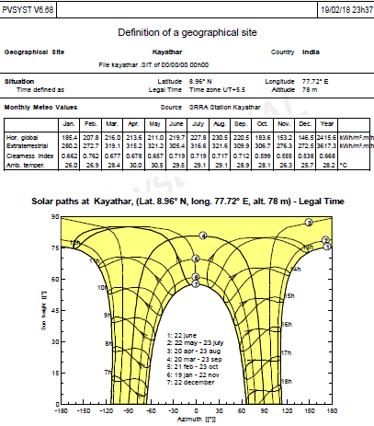
SOLAR DATA ANALYSIS
Meteonorm 10 years data 1981 to 1990
NASA – SSE 22 years data 1983 to 2005
SRRA – Kayathar 4 years data 2012 to 2016

Slide 15
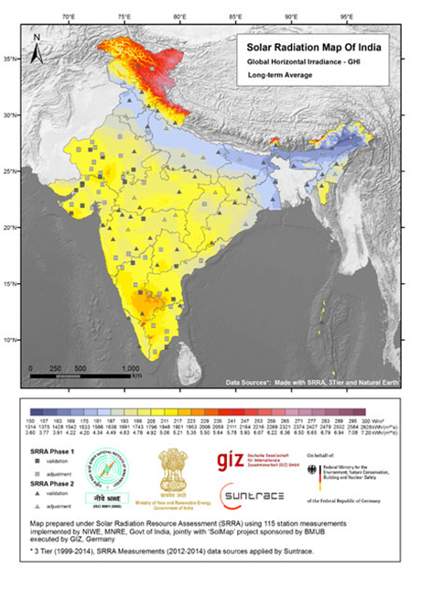
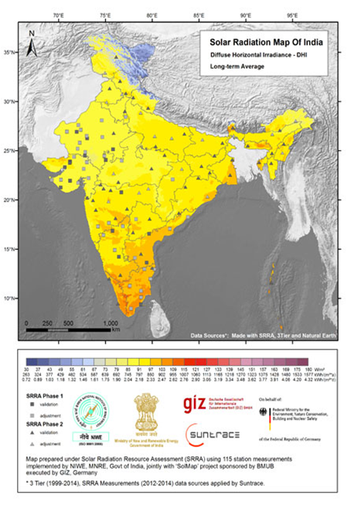
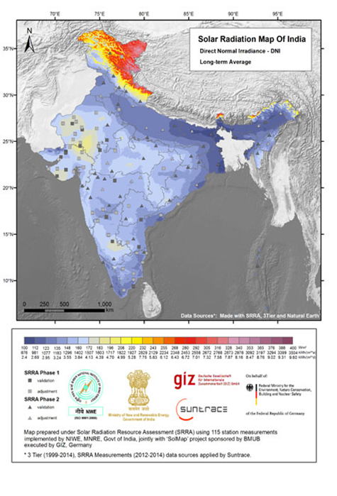
SOLAR MAPS
NIWE has launched the Indian Solar Radiation Atlas, with 3 km X 3 km spatial resolution, on 03.06.2015, providing details of solar resources at any location. GHI, DHI and DNI

Slide 16

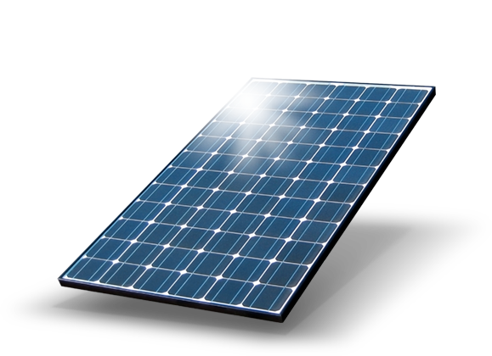

Solar Energy Technology and Applications

Slide 17
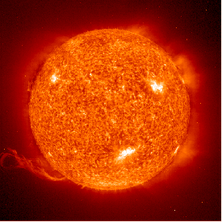
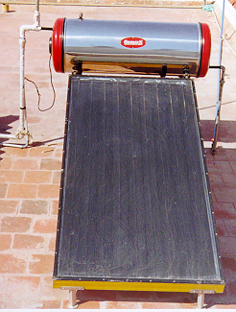
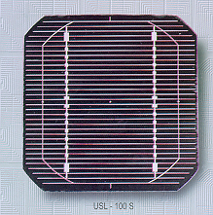
S O L A R E N E R G Y
H
E
A
T
E L E C T R I C I T Y

Slide 18

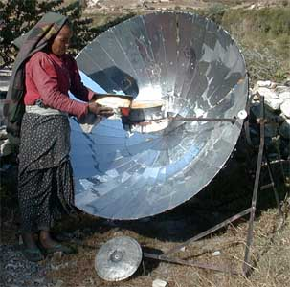
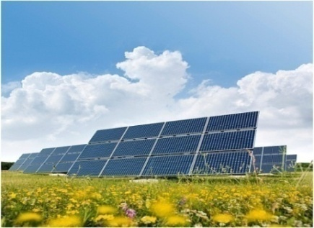
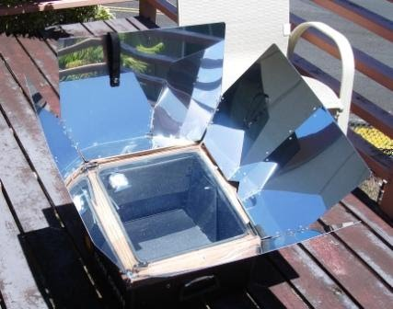
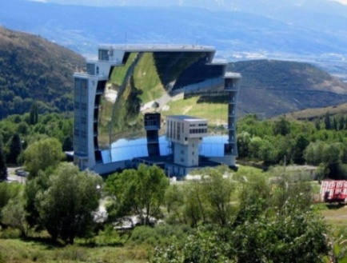

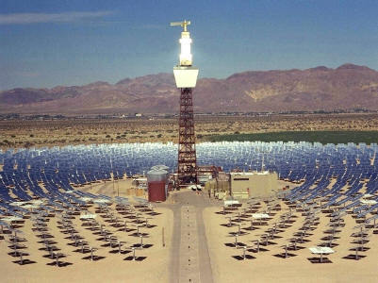

Solar Energy
Thermal
    Water Heating
    Dryer
    Cooker
    Oven
    Space Heating
    Thermal Electricity – Power Towers
Direct Electrical
    PV
Video

Slide 19
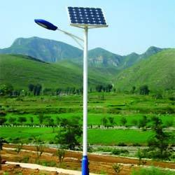
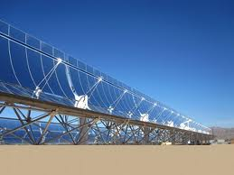
Solar Energy Applications
Street Lights
Parabolic concentrator

Slide 20
Typical Temperature Range & Efficiencies of Heating Systems
Name of System | Useful Radiation | Temperature Range (°C ) | Efficiency ( % )
Flat plate hot water heating | Global (direct+diffused) | 40 to 60 | 40
Evacuated tube water heating | Global | 50 to 80 | 50
Evacuated tube with other fluid and low concentration ratio | Direct | 100 to 200 | 50-60
Cylindrical parabolic collector | Direct | 100 to 400 | 50-60
Parabolic point focus | Direct | Up to 1000 | 70-80

Slide 21
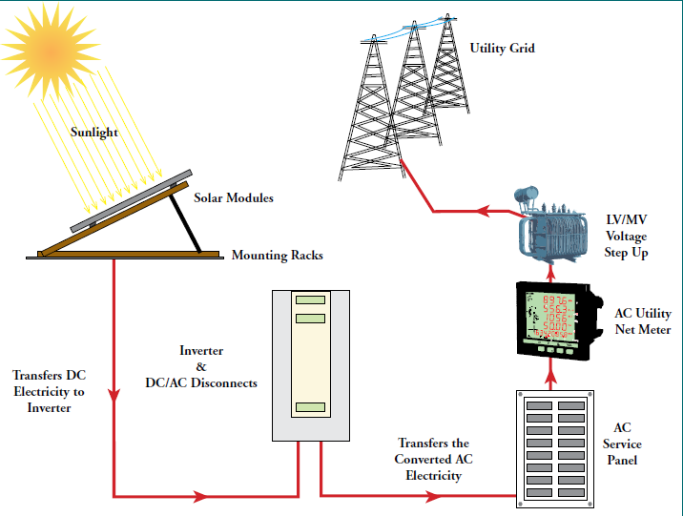
SOLAR PV TECHNOLOGY
Notes:
Overview of grid connected Solar PV system. The Government of India has set a challenging target of 40,000 MWp
of Grid
-
Interactive
Rooftop Solar PV Plants during the next five years. These rooftop solar PV plants will be set up
in residential, commercial, industrial, institutional sectors in the country ranging from 1 kWp to
500 kWp capacity. Such rooftop plants h
ave become economically viable as they produce clean electricity from the solar energy at about Rs. 7.0 per kWh without any subsidy. The Government
is providing a subsidy of 15% on these plants to the beneficiaries which makes it further attractive and viable.

Slide 22
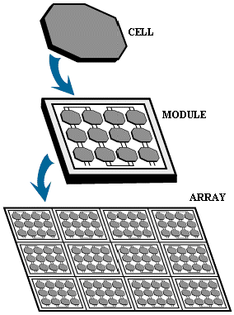
COMPONENTS OF SOLAR PV SYSTEM
The individual units that you place in the sun to produce electricity from the sun are called PV modules.
A number of modules connected together in different configurations form a PV array.
Notes:
-
Interactive
Rooftop Solar PV Plants during the next five years. These rooftop solar PV plants will be set up
in residential, commercial, industrial, institutional sectors in the country ranging from 1 kWp to
500 kWp capacity. Such rooftop plants h
ave become economically viable as they produce clean electricity from the solar energy at about Rs. 7.0 per kWh without any subsidy. The Government
is providing a subsidy of 15% on these plants to the beneficiaries which makes it further attractive and viable.

Slide 23
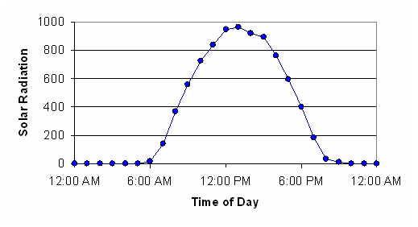
SOLAR IRRADIATION

Slide 24
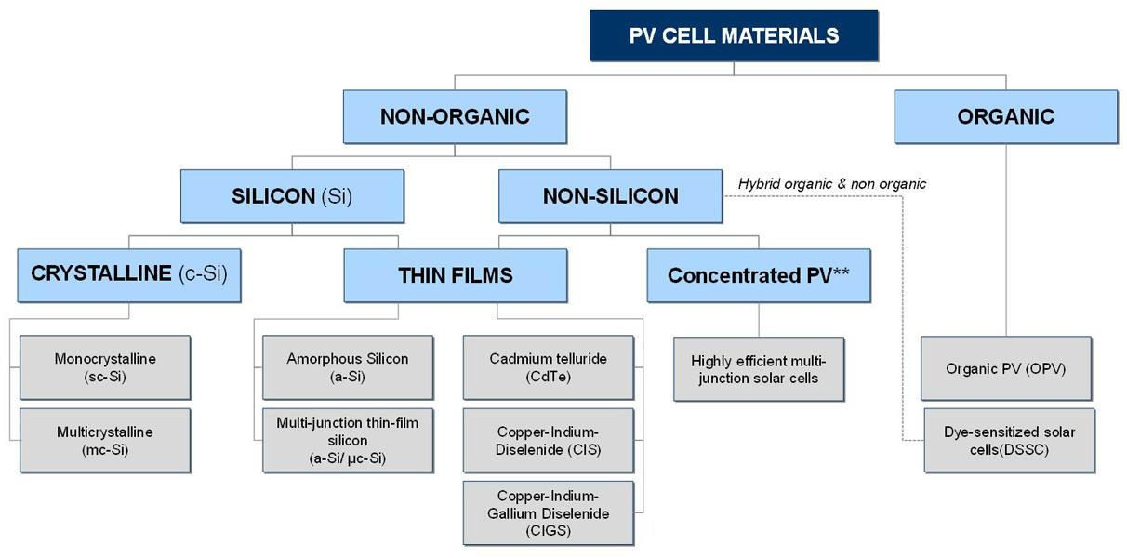
TYPES ON PANEL

Slide 25
COMPARISON TABLE
Solar Cell | Single Crystal | Poly Crystal | Thin Film | Multijunction | Organic
Advantages | -Very high efficiency -Easy to manufacture -Longevity | Cheaper compared to single crystal -As reliable as single crystal | -More flexible compared to crystalline -Cheaper than crystalline cells -Easy handling capabilities | -They capture every wavelength of light -Very high efficiency | Manufacturing cost is very less -Material availability is high
Disadvantages | -Very expensive -Fragile | Less efficient when compared to monocrystal | -Very less efficiency -Can’t be used for high power applications |  | -Very low efficiency

Slide 26
Parameters affecting Solar Panel output
Irradiation
Shading
Temperature
Mismatch
Soiling

Slide 27
Placing of Solar Panel
There are certain parameters which has to be considered while placing the panel.
Panel facing direction
Angle at which the
panel has to be kept
inclined

Slide 28
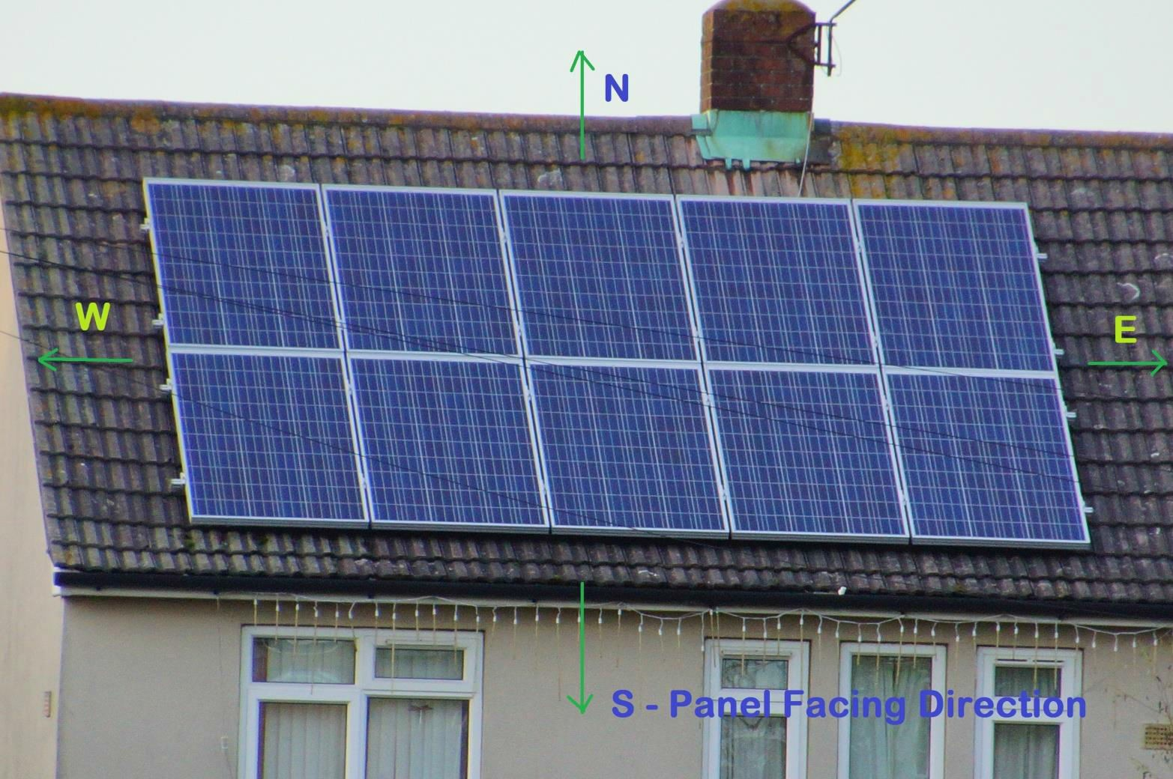
Panel facing direction

Slide 29
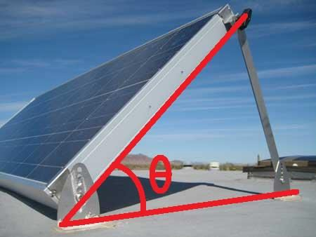
Tilt Angle

Slide 30
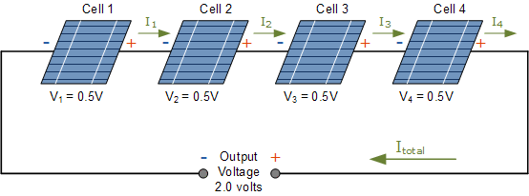
Series Connection

Slide 31
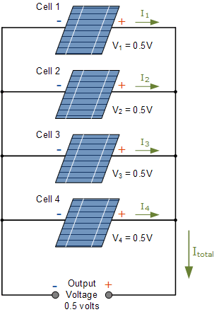
Parallel connection

Slide 32
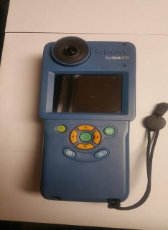
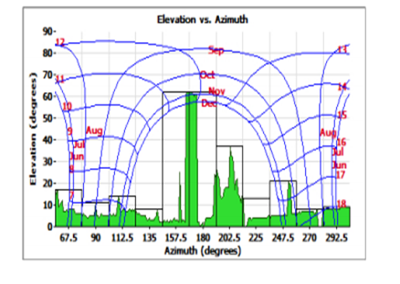
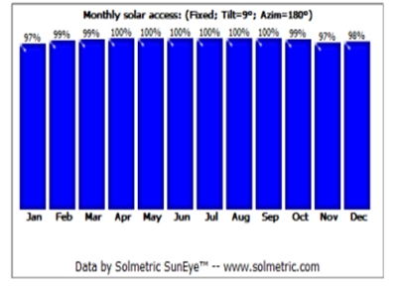
SHADOW ANALYSIS USING SHADE TOOL
Shade tool takes photograph of objects within 6 m² area from the point of measurement
It will generate shadow of object for complete one year period
Measurement to be taken to cover all objects in the entire study area

Slide 33

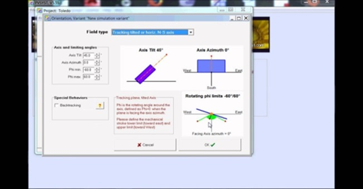
MODELLING OF SOLAR PV SYSTEM
Using PV Syst software tool, Solar PV system is modeled and the energy produced is estimated by applying nominal losses.
To estimate the energy yield from the proposed solar PV system, solar data in the form of GHI, Temperature, available shadow free area, loss details, orientation, PV technology like panel type & capacity, Inverter details were given as input.
The annual energy prediction with P50 is preferred.
Notes:
Inputs for PV syst software:
Solar Data : GHI & Temperature
Area available: m²
Project Design : Stand alone or grid connected
Orientation : Fixed tilt, seasonal tilt, single axis, two axis tracking
Technology : Panel type - Mono, Poly, Thin
Panel Capacity
Inverter Capacity
Loss details : Soil, Transmission, unavailability,Ohmic losses

Slide 34
Power Generation from Solar PV system
Month | Generation (Kwh)
Jan | 245700
Feb | 268800
Mar | 310200
Apr | 302400
May | 294800
Jun | 259200
Jul | 251200
Aug | 254700
Sep | 249600
Oct | 227100
Nov | 199200
Dec | 210700
Total | 3073600

Slide 35
THANK YOU

